Slide 1

Home Equity Loan Default Prediction:
A Machine Learning Approach
By:
Jacob Stys

Slide 2
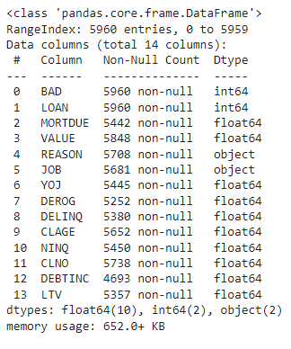
Dataset Details
Contains 5,960 Rows with 13 independent variables.
The dependent variable is if the loan defaulted (1) or was paid off (0).
Data was obtained from Kaggle-https://www.kaggle.com/datasets/ajay1735/hmeq-data
About 20% of the data were defaulted loans and 80% were paid off loans.
Description of independent variables can be found on the Kaggle site.

Slide 3

Dataset Importance and Uses
Rising Mortgage rates have affected the housing market recently.
Home owners are having difficulty paying their mortgage as interest rates rise.
Having the ability to have a home equity loan gives people the ability to consolidate credit cards, remodel a home, or consolidate debt.
This is an important topic for loan officers and underwriters to successful approve loans without having to worry about the loan defaulting.

Slide 4
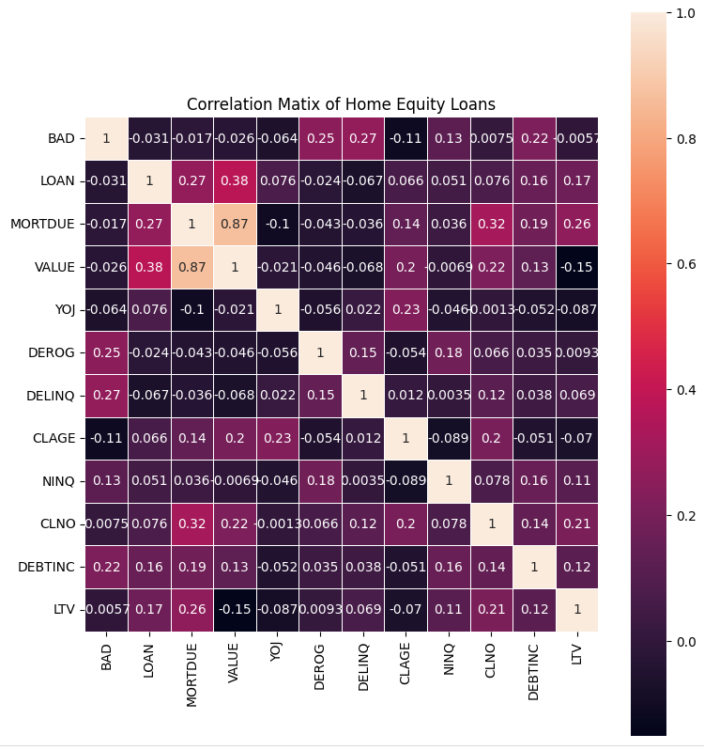
Data Cleansing and Exploration
Decided to drop missing values in the dataset.
300 defaulted loans and 3,064 paid off loans, totaling to 3,364 row values.
Created a loan to value ratio variable as it is used in approving loans.
Created a correlation map to detect any relationship between independent variables and the dependent variable.
Got some correlation with Debt to Income ratio, Mortgage Due, loan value, and home value, as well as some categorical variables in the data.
This correlation map also checks for multicollinearity and it turns out that there is no multicollinearity within the data.

Slide 5

Significant Variables
In the Model
Encoded significant categorical variables using dummy variables which include: Job type, Years on Job, derogatory reports, delinquent credit cards, and NINQ.
Significant continuous variables include: Loan amount, Mortgage Due, home value, Age of oldest trade line in months, Loan to value, and Debt to income ratio.

Slide 6

Goal and Metrics
Goal of this project is to predict if a Loan will default given the selected variables.
Using accuracy and recall will give an idea how well the model is performing.
The higher the recall the more predicted loans the model has predicted to be defaulted.

Slide 7
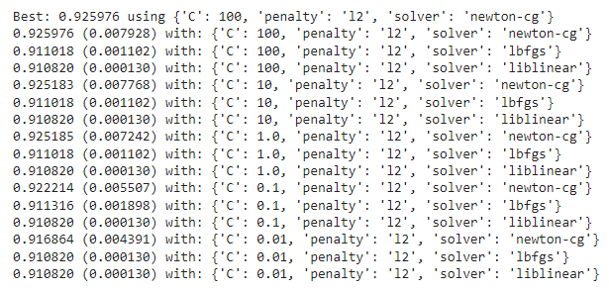
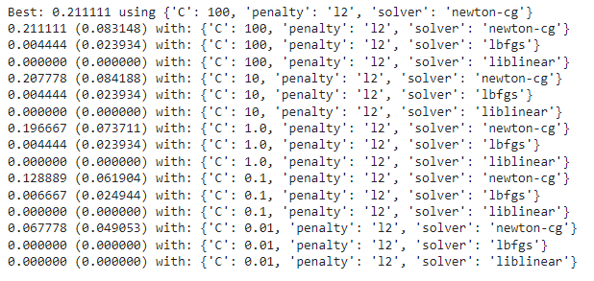
Logistic Regression
First model is Logistic Regression since this is a classification problem.
Used libraries from sklearn include:: RepeatedStratifiedKFold, GridSearchCv, and Logistic Regression
Used 10 kFoldCrossValidation to overcome any overfitting of the data with 3 repeats.
Best model hyperparameters include a C value of 100, L2 penalty, and newton-cg solver.
Obtained an Accuracy of .926 and a recall of .211.
Overall our model had a strong accuracy but a low recall so this model is not significant enough to be used.

Slide 8
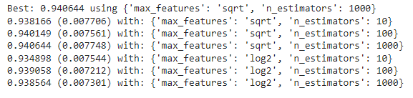
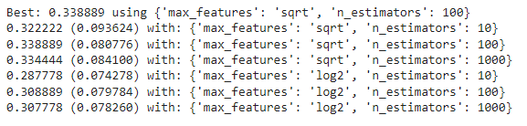
Random Forest Classifier
Repeated steps from the Logistic Regression but used different hyperparameters.
Tested for n_estimators in the model (10, 100, 1000) as well as max_features in the model (square root or log).
Best accuracy of .941 with max_features as square root and n_estimators as 1000.
Best recall record was .340 with max_features as square root and n_estimators as 100.
Different parameters lead to different results.
Either of the models could be used to predict the data but a stronger recall is more preferred.
Model made some improvements to the data but there is more room for improvement when it comes to the recall value.

Slide 9
Gradient Boosting Classifier
Repeated step from previous models but doing 5 cross validations and 3 repeats.
Hyper parameters to test include subsample .7 or 1, n_estimators 100 or 1000, max_features .3, .35, .4, and max depth of 4, 7, 9.
All tests have a learning rate 0.1.
Results showed an Accuracy of 0.947 and a recall of 0.456.
The hyperparameters used for accuracy include max_depth of 7, max_features of 0.35, n_estimators of 1000, and subsample of 0.7.
The hyper parameters used for recall include max_depth 0.4, mac_features of 0.35, and n_estimators of 1000.
This being the highest accuracy and recall scores using this model would be ideal.

Slide 10
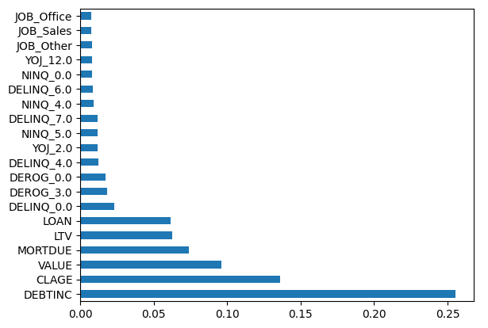
Conclusion
After assessing the dataset we can conclude the following:
The more complex the model becomes the stronger the accuracy and recall was returned
Dataset had around 3000 values so having more data could lead to better models and insights.
Predictability was great when it came to precision but average when it came to recall.
Some variables like tax, life style, and number of kids could play a factor in predicting a loan would default or not.
Overall having an Accuracy of 0.947 and a recall of 0.456 from the Gradient Boosting Classifier is okay but would prefer a stronger recall.
List of Feature importance of the gradient boosting classifier.

Slide 11
Links
Data-https://www.kaggle.com/datasets/ajay1735/hmeq-data/code
Github-https://github.com/jake052799/ThinkfulProjectsAssessmentsandData/tree/main/Capstone%20Folder/HMEQCapstone2
CodeEX-https://machinelearningmastery.com/hyperparameters-for-classification-machine-learning-algorithms/

